Slide 1
KoçDigital CV Use Cases
15 MAY2020

Slide 2

Mustafa Kara
Introductions
Introductions
Data Scientist, KoçDigital
Education
Master’s degree, Mathematical Engineering, Yıldız Technical University (present)
Bachelor’s degree, Mathematical Engineering, Yıldız Technical University

Slide 3

Acar Erdinç
Introductions
Introductions
Data Scientist, KoçDigital
Education
Master’s degree, Computer Engineering, Bilkent University
Bachelor’s degree, Computer Engineering, Işık Univeristy

Slide 4
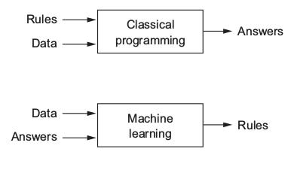
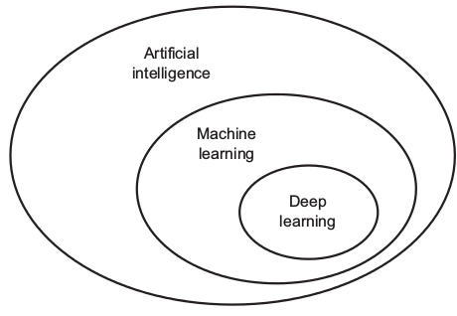
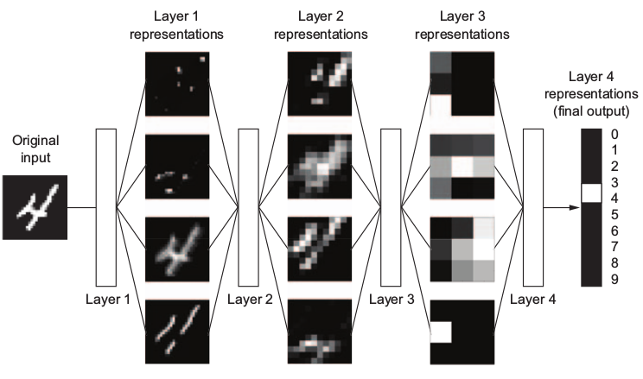
What is Deep Learning?
Machine Learning
Deep Learning
Notes:
Burada why deep learning ve why now konularına değinilebilir. Hardware, datasetlerin artması, açık kaynak kodlarının artması, kütüphanelerin geliştirilmesi anlatılabilir.

Slide 5
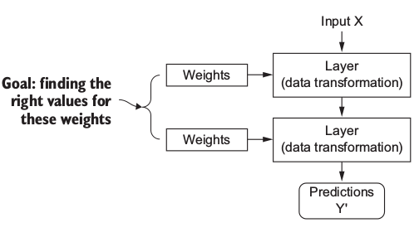
How to train your Deep Learning Model?
Step 1 – Model is parameterized by its weights

Slide 6
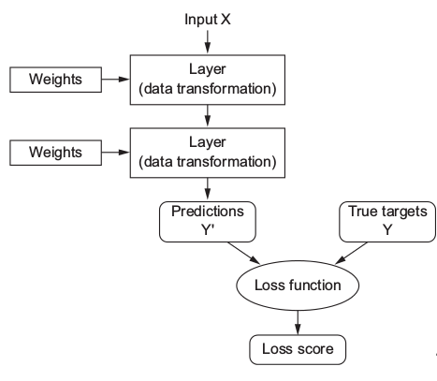
How to train your Deep Learning Model?
Step 2 – Loss Function / Objective Function

Slide 7
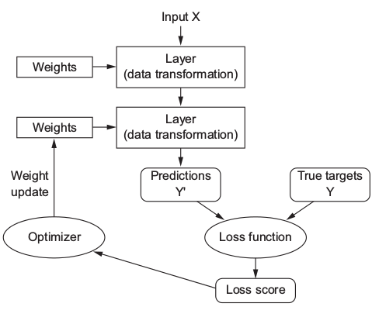
How to train your Deep Learning Model?
Step 3 – Backpropogation

Slide 8
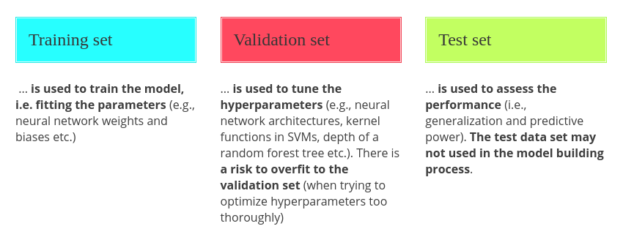
Training, Testing and Validating

Slide 9
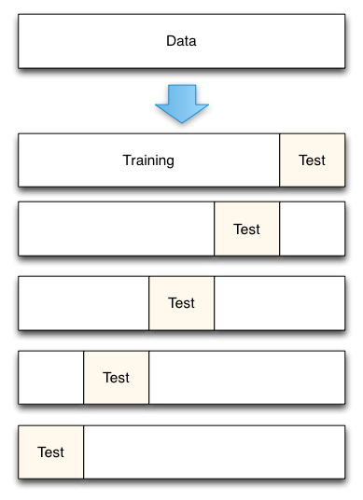
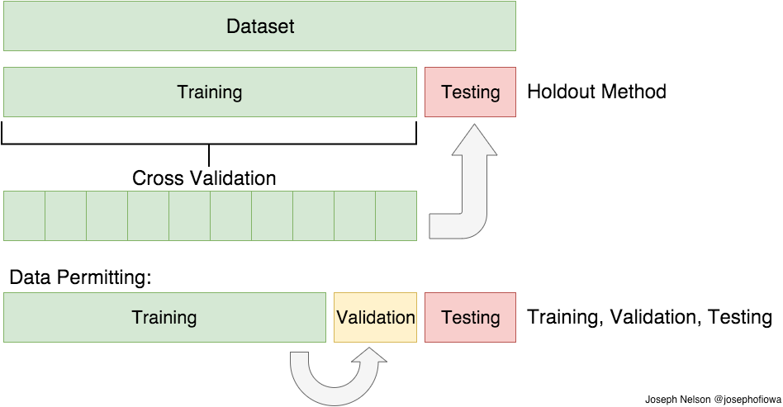
Cross-Validation

Slide 10
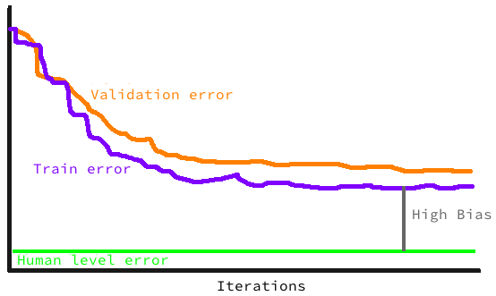
Bias-Variance Tradeoff
High Bias
Solution:
Bigger Model
Train Longer
New Architecture

Slide 11
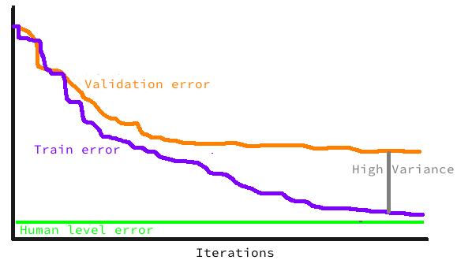
Bias-Variance Tradeoff
High Variance
Solution:
Regularization
More Data
New Architecture

Slide 12
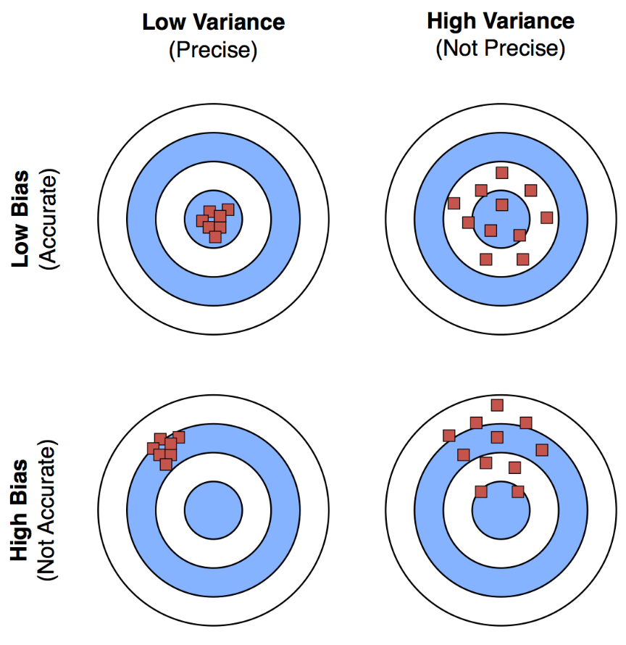
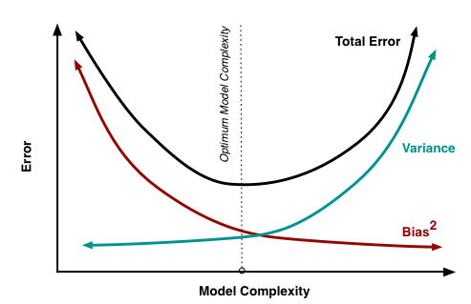
Bias-Variance Tradeoff

Slide 13
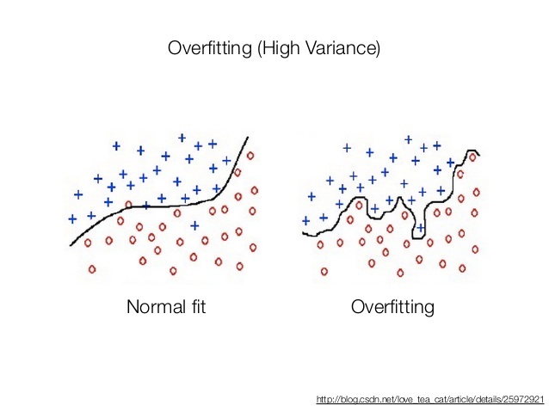
Overfitting
Solution:
Simple Models
Cross Validation
Regularization
Get More Data
Ensemble Model

Slide 14
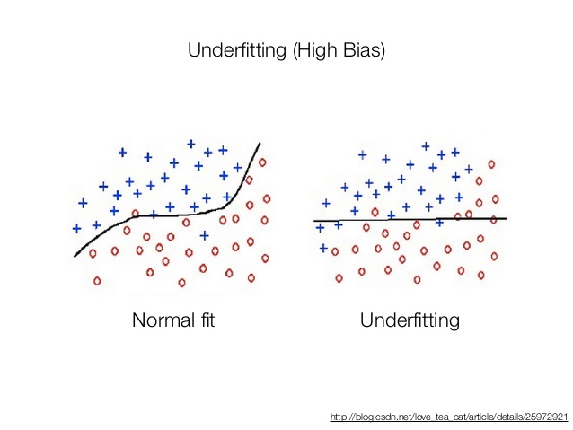
Underfitting
Solution:
More Training Epoch
Complex Models

Slide 15
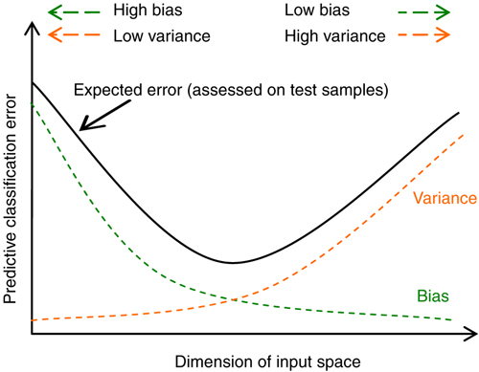
Overfitting vs. Underfitting

Slide 16
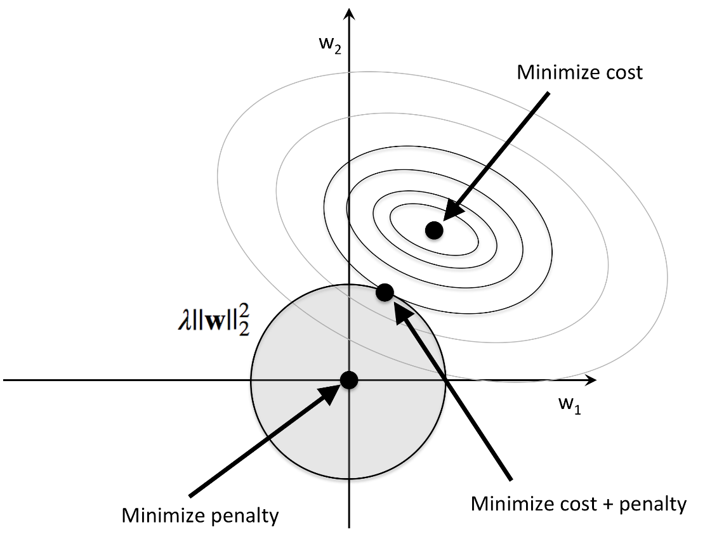
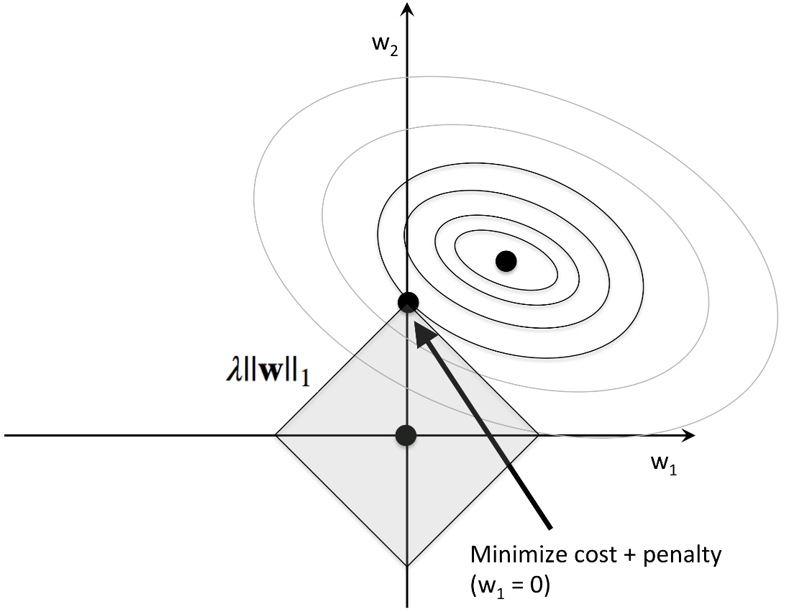
Regularization
Ridge Regression
Lasso Regularization

Slide 17
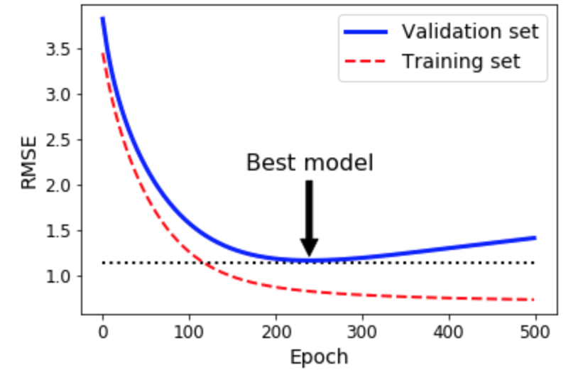
Regularization

Slide 18
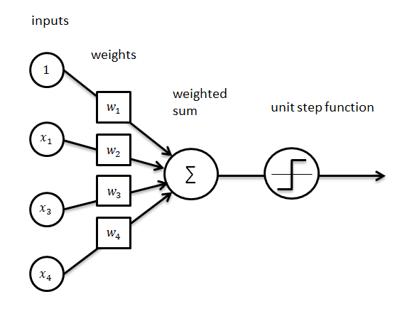
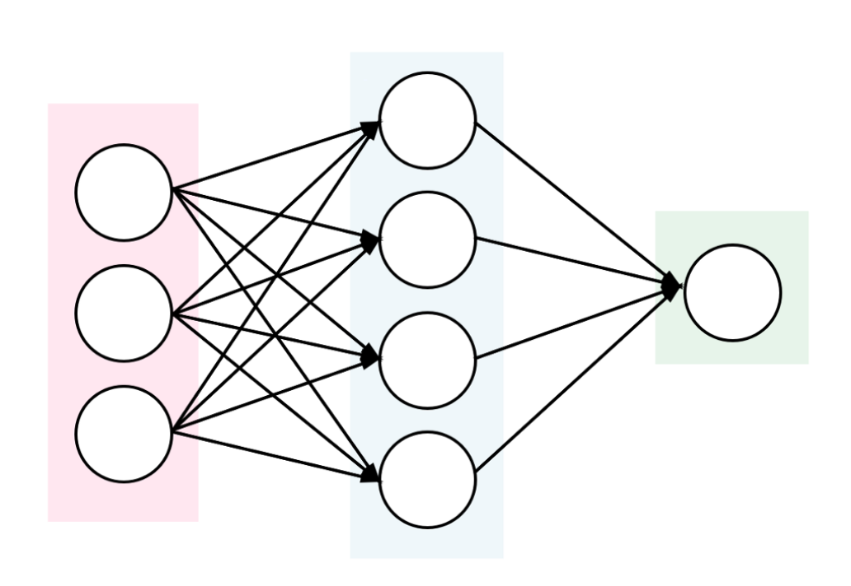
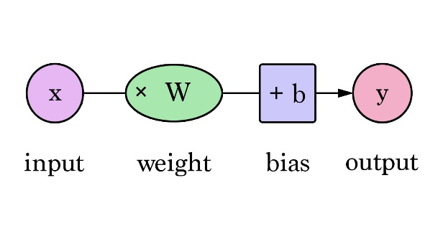
Neural Network in a nutshell
Zoom in one Node

Slide 19
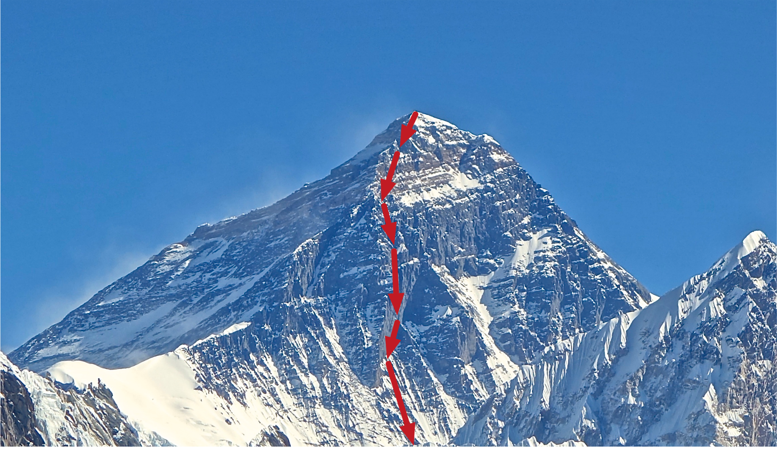
Gradient Descent

Slide 20
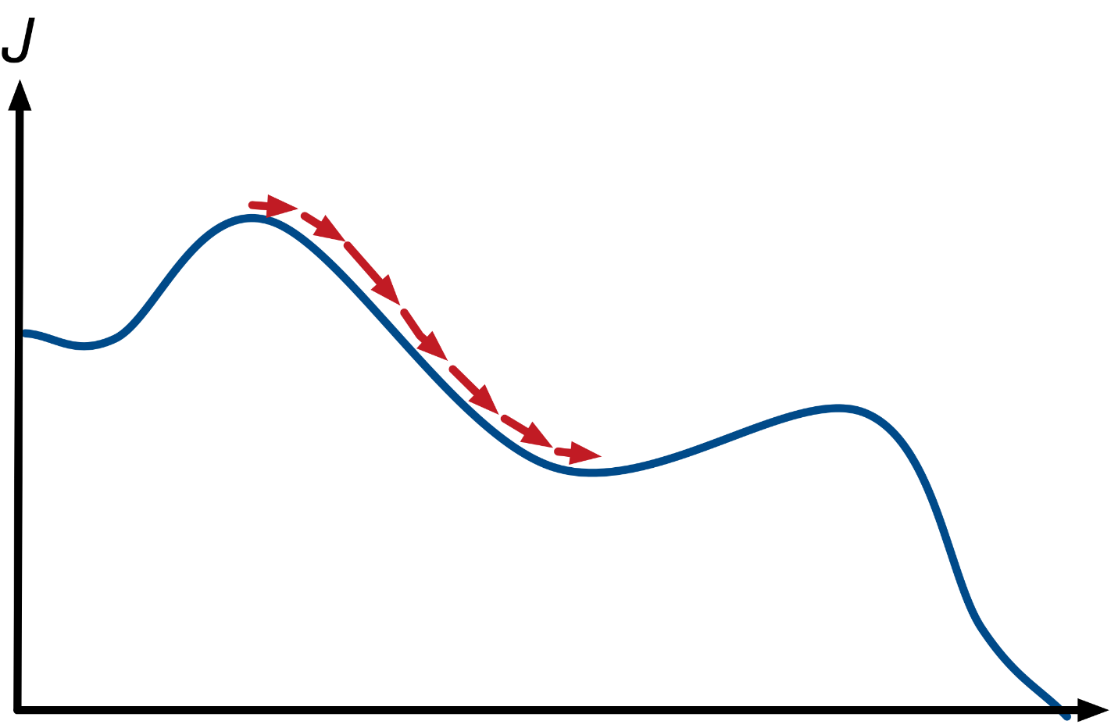
Error/Loss Function
How to minimize Loss function?
Start with random values for W and b
Compute gradients of J with respect to W and b
Take a small step (learning rate) along the direction of the negative gradient
Go back to step 2

Slide 21
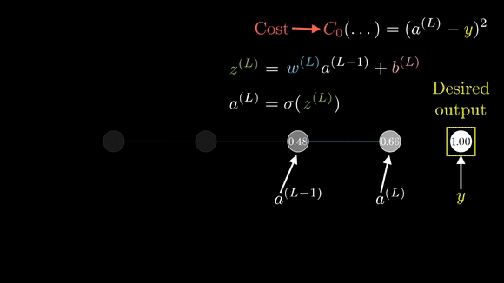
Backpropogation

Slide 22
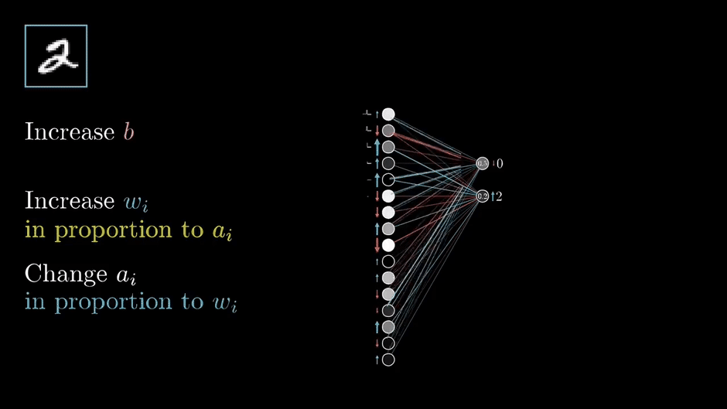
Backpropogation

Slide 23
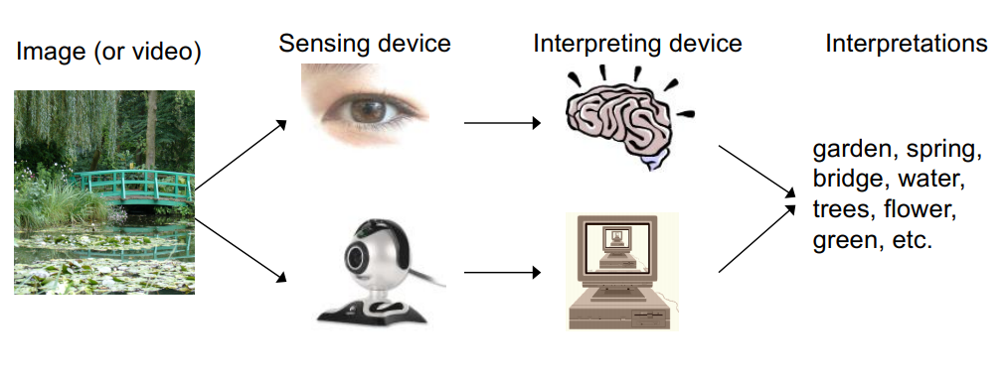
What is Computer Vision?
Source: Stanford University

Slide 24
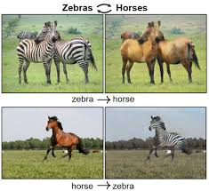
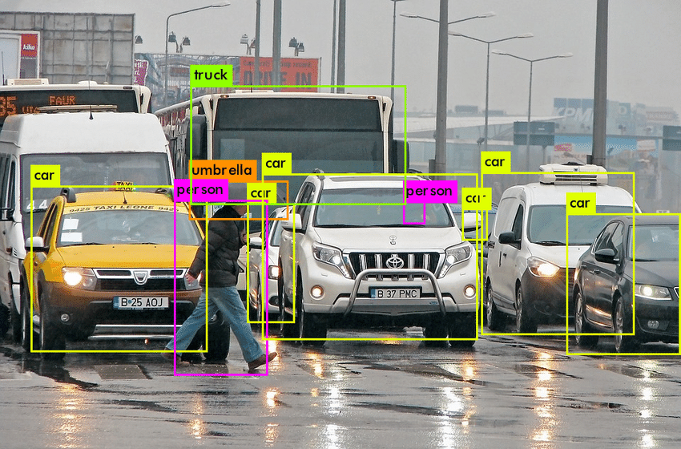
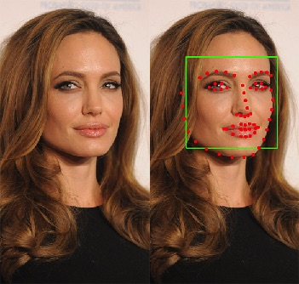
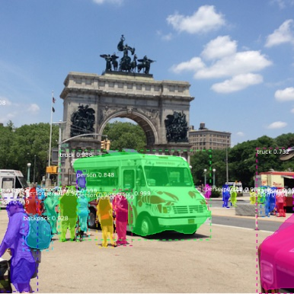
Computer Vision Applications
Image Classification
Generative Networks
Object Detection
Landmark Detection
Object Segmentation
Face Recognition

Slide 25
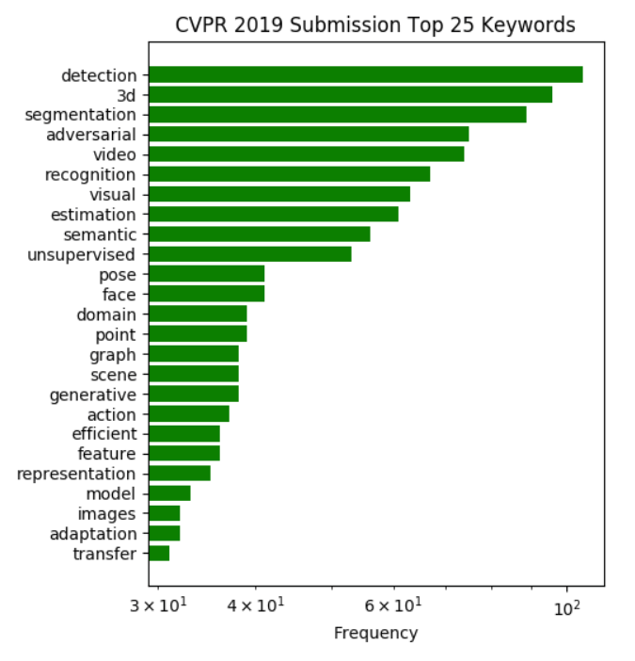
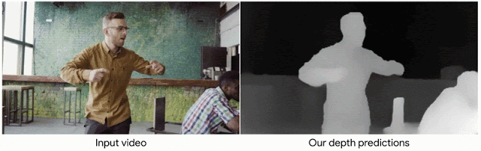
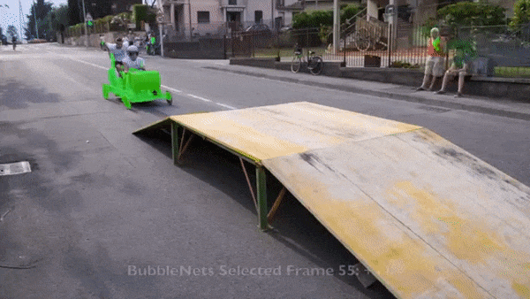
Computer Vision Trends
Source: https://towardsdatascience.com/latest-computer-vision-trends-from-cvpr-2019-c07806dd570b

Slide 26
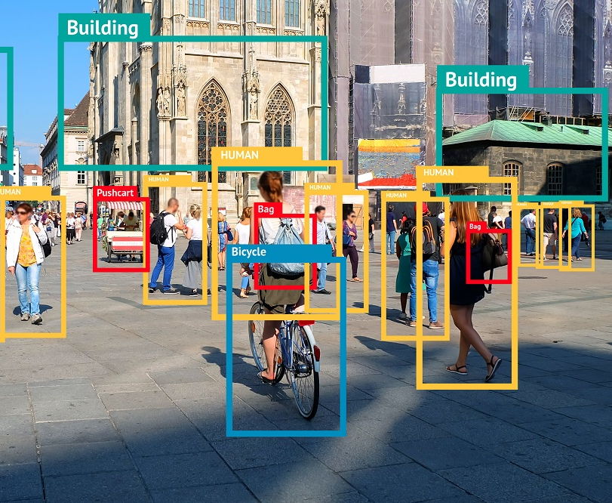
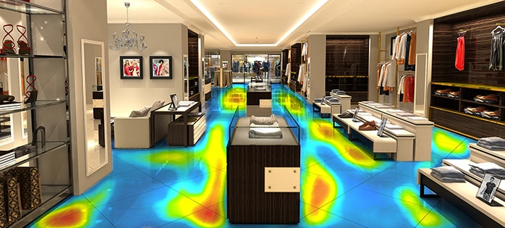
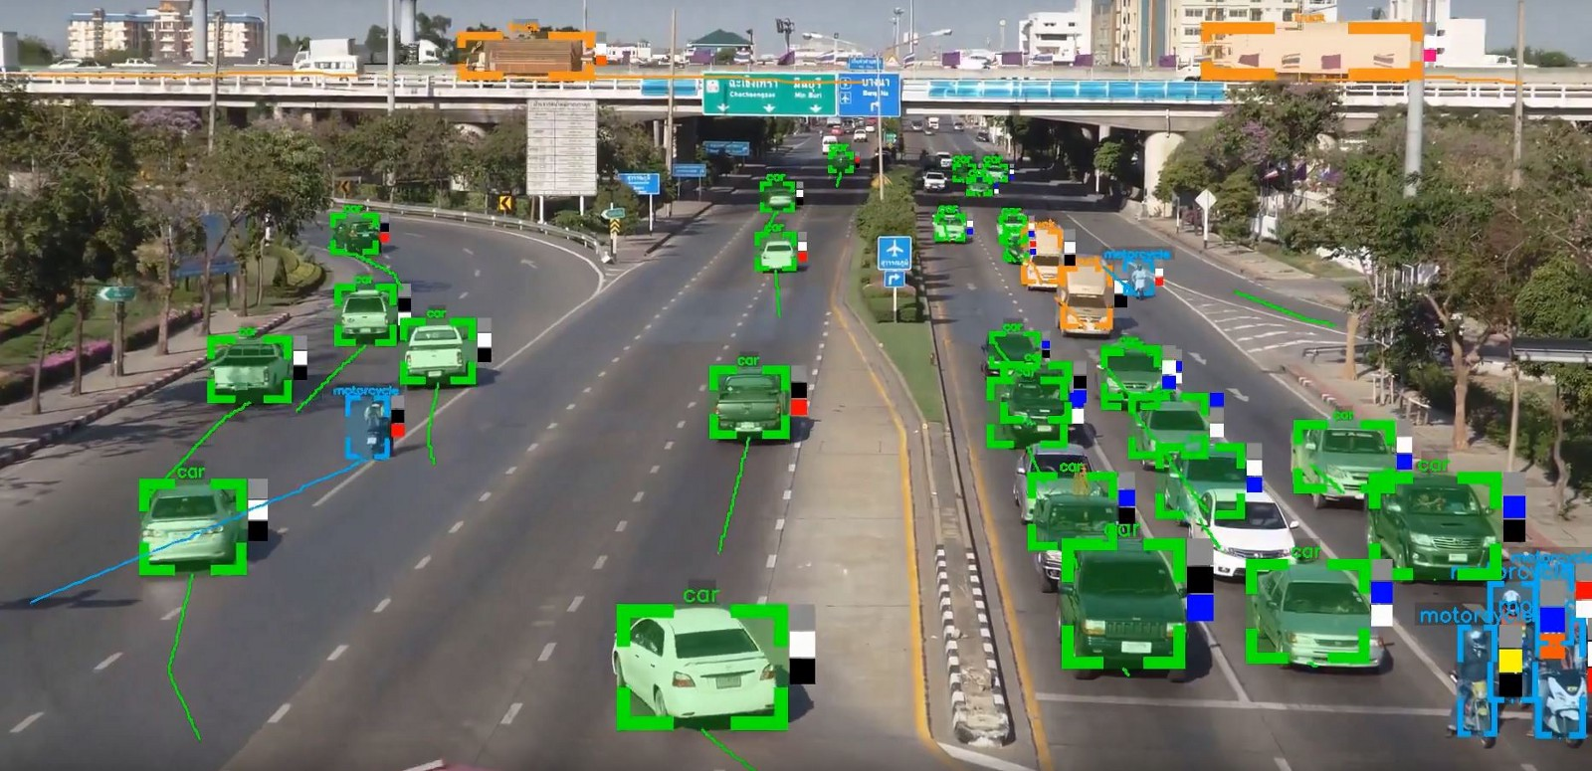
Intelligent Video Analytics is…
Intelligent
Video Analytics
Adding artificial intelligence to cameras in order to…
…analyze video content in real-time
...extract metadata
… and provide actionable intelligence

Slide 27
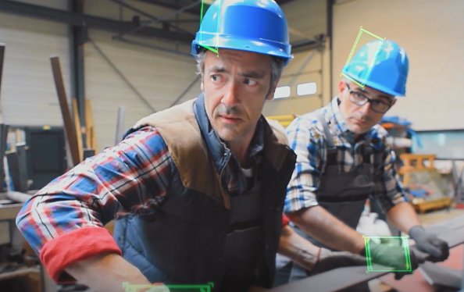
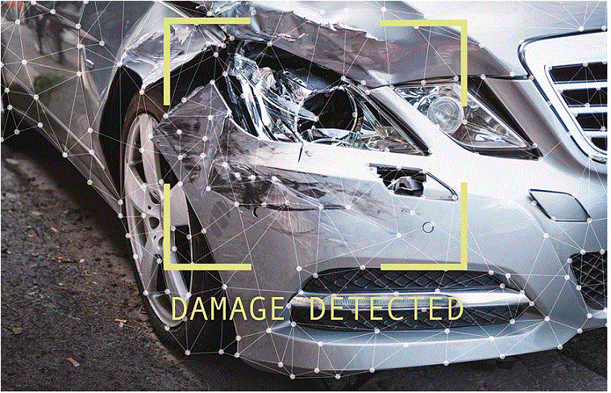
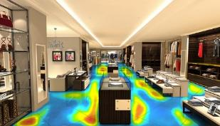
Video Analytics Vertical Solutions
Our Intelligent
Video Analytics Offering
Safety & Security
Area violation
Protective equipment usage
Handrail usage
Predictive Quality
Defect detection
Scratch detection
Pattern continuity
Retail Pack
Customer count
Demographics
Object detection
Source: KoçDigital

Slide 28

Video Analytics Solution Family
Our Intelligent
Video Analytics Offering
Safety & Security
Area violation
Protective equipment usage
Handrail usage
Predictive Quality
Defect detection
Scratch detection
Pattern continuity
Retail Pack
Customer count
Demographics
Object detection
Video Analytics Platform
Proactively detect threats
Perform smart investigations
Real-time alerts from
HMI screens & Application
Hardware
Server
(GPU, Ram)
Camera
(IP, Thermal, Line)
Edge
(Nvidia Jetson, Rasp, Custom)
Cloud (PaaS)
(Private, Public, Hybrid)

Slide 29
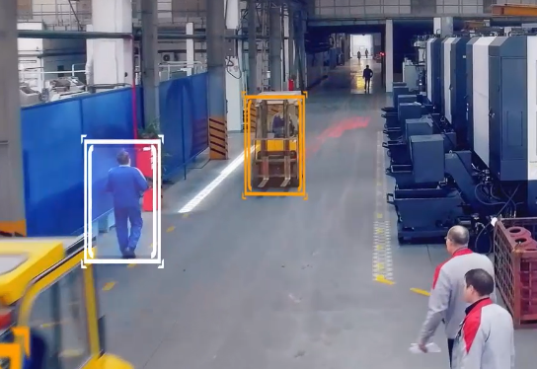
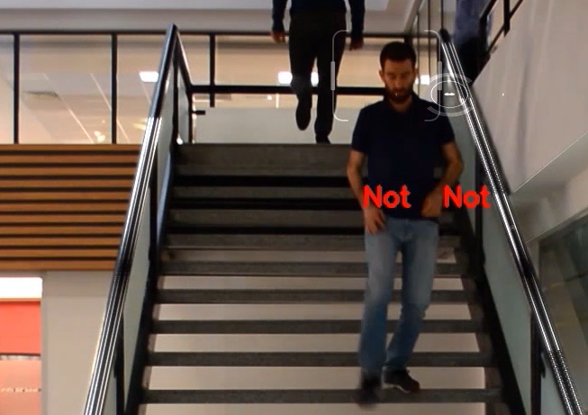
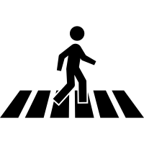
Health and safety solution for an FMCG company factory
Our Intelligent
Video Analytics Offering
Crosswalk violation detection
Protective gloves detection
Handrail violation detection
Safety problems: Violation of crosswalk may cause accidents with very serious consequences
To detect pedestrians not in the pre-defined areas
Safety problems: Not using protective equipment may cause accidents in critical processes
To detect workers not using protective equipment while working such as gloves or helmet
Safety problems: Violation of handrail usage may cause falls on stairways
To detect workers not holding handrails

Slide 30





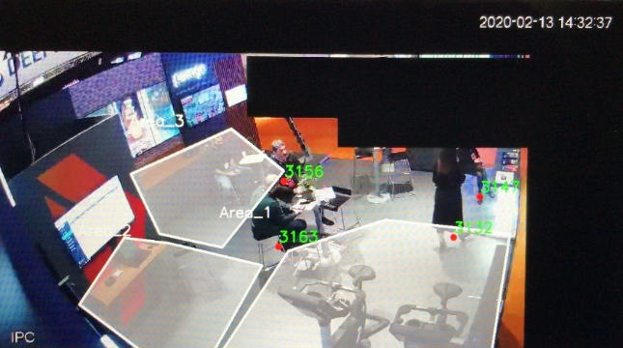

Retail solution for a stores and malls
Context and challenges
KoçDigital approach
Impact
Challenges
IP Camera might not see customer's face because of its angle.
Architecture
~1 month effort of a data science team
Used Yolo v3 to detect customers and Deep Sort to track them.
Used MTCNN to face detection and alignment
Used pre-trained deep learning model which was trained on IMDB-WIKI dataset for the age and gender classification.
Area based demography analysis
Traceable customer journey
Detection of crowd areas

Slide 31
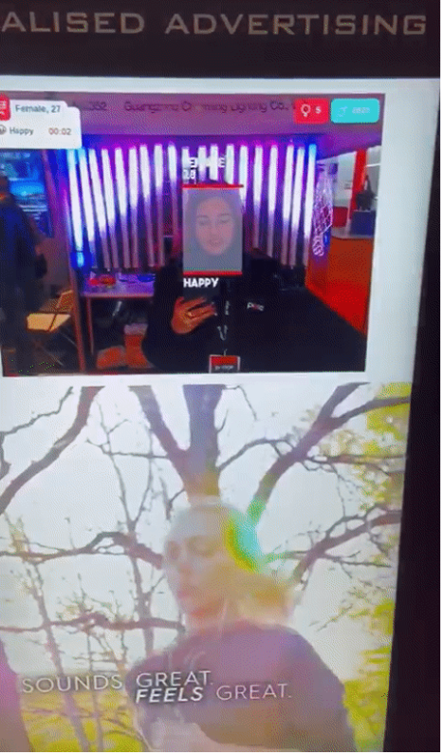
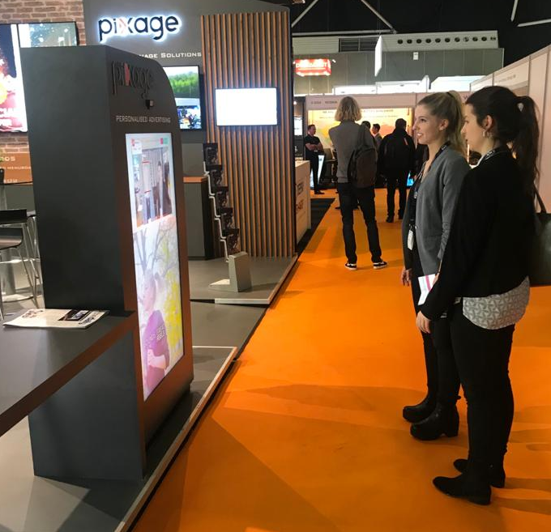
Retail solution for a stores and malls
Context and challenges
KoçDigital approach
Impact
Challenges
Background light might make face darker
Architecture
~1 month effort of a data science team
Used dlib face detector to face detection.
Used multiple pre-trained deep learning models to classify age and gender classification.
Used pre-trained deep learning models to sentiment classification.
Reach target customers
Demographic based advertisement report
Advertisement effect analysis on customer

Slide 32
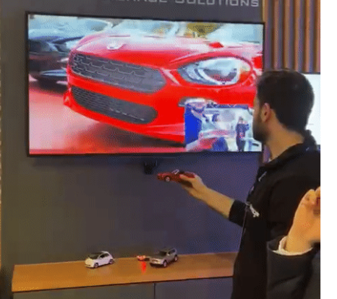
Retail solution for a stores and malls
Context and challenges
KoçDigital approach
Impact
Challenges
Similar objects might cause false detection
Architecture
~1 month effort of a data science team
Collected and labeled data from 3 different cars
Used Transfer Learning technique on pre-trained Yolo v3 deep learning model
Our model work with ~%85 accuracy
Intereactive advertisement with product
Promote custom product

Slide 33
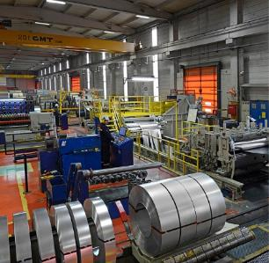
Health and safety solution for an steel manufacturer company factory
Context and challenges
KoçDigital approach
Impact
Challenges
Even though customer has cameras on the field, they are not used for real-time monitoring
No real-time analytics can be run on the current environment, all efforts had to be manual.
Randomly selected videos may lead to missing out of the HSSE breaches
Key client question:
Company aims to decrease work accidents caused by manufacturing area process violations.
~4 month effort of a consulting and data science team
Used Mask RCNN to detect workers.
Designed a custom deep learning model for the door’s open/close status and production line’s working/not working status.
Our custom models work with ~%90 accuracy.
%90+ correct detection in all scenarios
Enhanced customer safety and security experience
Decreased momentary false alarms
Enabled real-time monitoring
Door
open/close
Area
violation check
Production
active

Slide 34
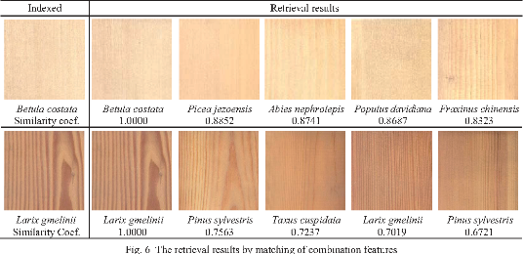
Texture classification for wooden panel industry company
Context and challenges
KoçDigital approach
Impact
Challenges
Wood panel designs can be mismatched and resulting wrong implementations of final product.
Key client question:
Company aims automate design pattern match with video analytics
Classification algorithms are used for pattern recognition and alert for mismatch cases.
Edge device with camera is used for increased mobility.
Cost reduction from mismatched products
Faster texture classification with high accuracy

Slide 35
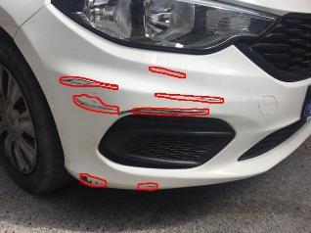

Detection of damage severity on cars for a car retail company
Context and challenges
KoçDigital approach
Impact
Challenges
Experts are not at field and make decisions based on images taken by car repair service points
Images do not have any standarts and are taken under different conditions
Key client question:
Company aims to asist car experts and reduce spare parts demand
~1 month effort of data science team
Used 3 different POC approaches
Designed a custom deep learning model for damage detection
Our custom models work with ~%90 accuracy.
Reduction at expertise services
Reduction car repair times and increase in car rental days
Reduction spare parts and labor costs

Slide 36

Health and safety solution for an steel manufacturer company factory
Context and challenges
KoçDigital approach
Impact
Challenges
Glasses are transparent
Key client question:
Company aims to decrease work accidents caused by manufacturing area process violations.
~1 month effort of a consulting and data science team
Used Transfer Learning technique on pre-trained Yolo v3 deep learning model to detect helmet
Used Transfer Learning technique on pre-trained ResNet deep learning model to classify whereas workers wear glass or not
All time Work Safety control
Detect worker who do not use helmet or glasses

Slide 37


KoçDigital Intelligent Video Analytics Software offers various solutions for safety and security problems
Our Intelligent
Video Analytics Offering
Not Exhaustive
DETECTION
RECOGNITION
CROWD MANAGEMENT
TRACKING & PATHING
Protective Equipment Usage Detection
Perimeter Monitoring
Intrusion Detection
Fallen Person Detection
Loitering Detection
Abandoned Object
Anomaly Detection (Fire & Smoke)
Facial Recognition
Vehicle Plate Recognition
People Counting
Entry/Exit Counts
Overcrowding on working area
Crosswalk Usage Monitor
Rail usage on stairs
Flow Control
Path Analysis
Vehicle/machine movement
Implemented with customer project/poc

